Slide 2

^{From Slow to Pro}
Accelerating Kubernetes Native Development with Kind & DevSpace
Notes:
Hi everyone! Welcome to the final session of KubeCon + CloudNativeCon India 2025. I know it's been an intense two‑day ride, so thanks for sticking around. Let’s wrap things up by learning how to go from “Slow” to “Pro” and turbo‑charge your Kubernetes‑native development with Kind and DevSpace.

Slide 3
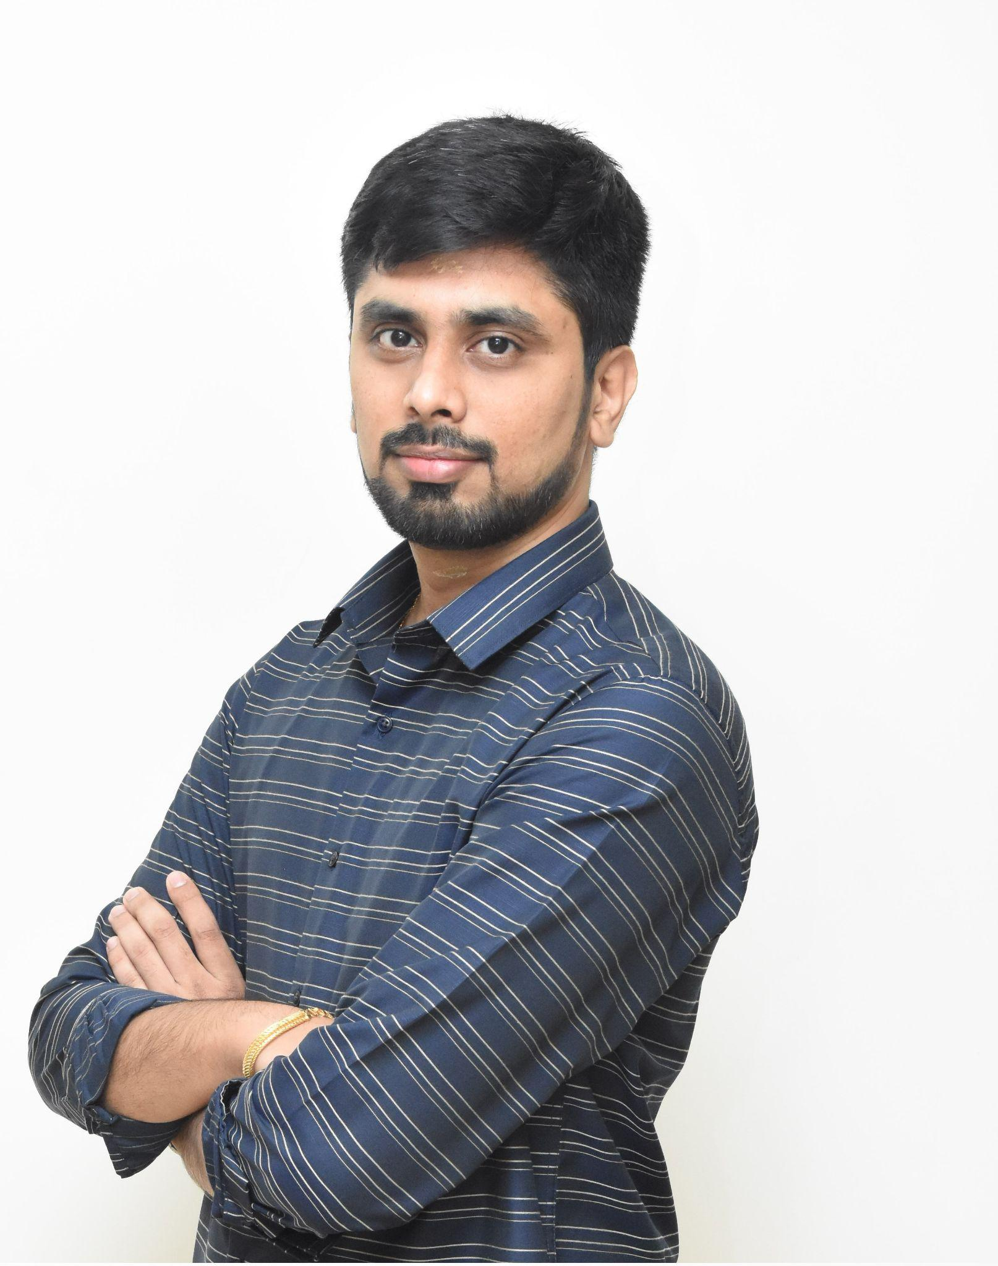
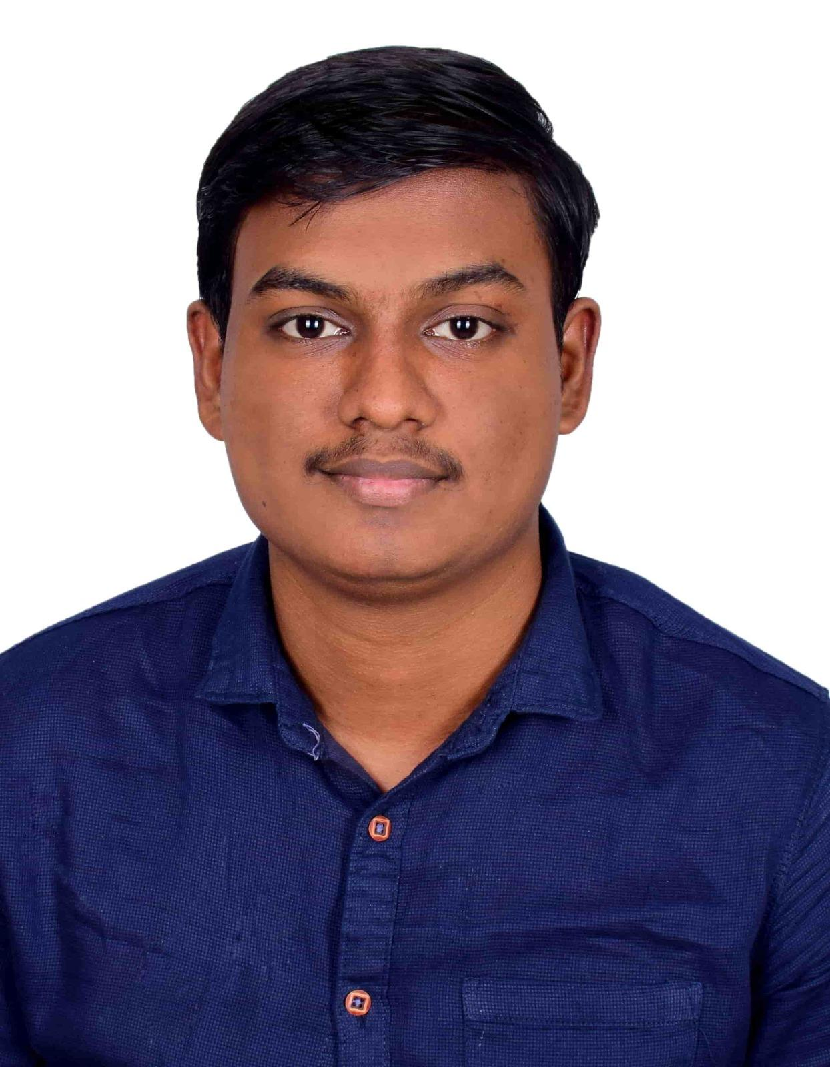
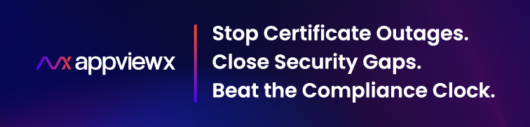
About Us
Raghu Chandrasekaran
Solutions Architect
Naveenkumar Kumanan
Software Development Engineer
Notes:
I’m Raghu, Solutions Architect at AppViewX—we help the world’s largest enterprises keep their TLS certificates healthy. I designed our multi‑tenant message bus and led the journey to SaaS: on‑prem runs on kubeadm, the cloud on EKS, and edges on K3d.
With me is Naveen, Software Engineer on the same platform. I worked on Near-zero‑downtime upgrades—even database migrations with CDC.
We’ll share the pain we felt joining the team and how Kind + DevSpace turned build‑deploy cycles from drag to delight.

Slide 4

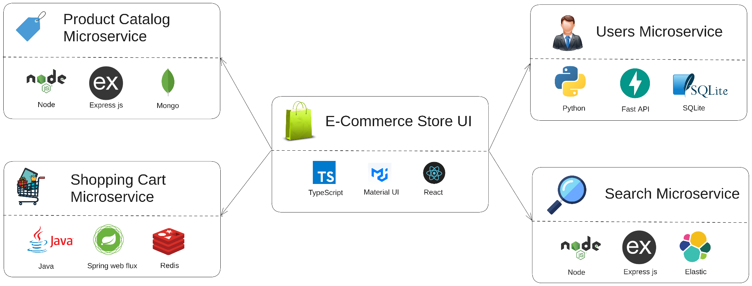
Meet Aditya: Week 1 at Clusterly
Aditya’s first week at Clusterly:
• Clusterly an e-commerce giant has polyglot microservices
• His first assignment - Fix a simple bug
Architecture inspired by @venkataravuri's ecommerce-microservices-sample. Forked and customized for the fictitious Clusterly e-commerce app.
Notes:
Meet Aditya—a brand‑new SDE at Clusterly, an e‑commerce giant. His first ticket sounds trivial: fix a bug in cart service. Reality check: Clusterly’s storefront is five microservices—Node/Express + Mongo, Java/Spring + Redis, Python/FastAPI + SQLite, Node/Express + Elastic, plus a TypeScript‑React UI—all orchestrated on AKS.
To change one line, Aditya needs the whole graph running locally. Painful déjà‑vu for many of us. Let’s walk through his struggle, then we’ll show how Kind and DevSpace turn this maze into a sprint.

Slide 5
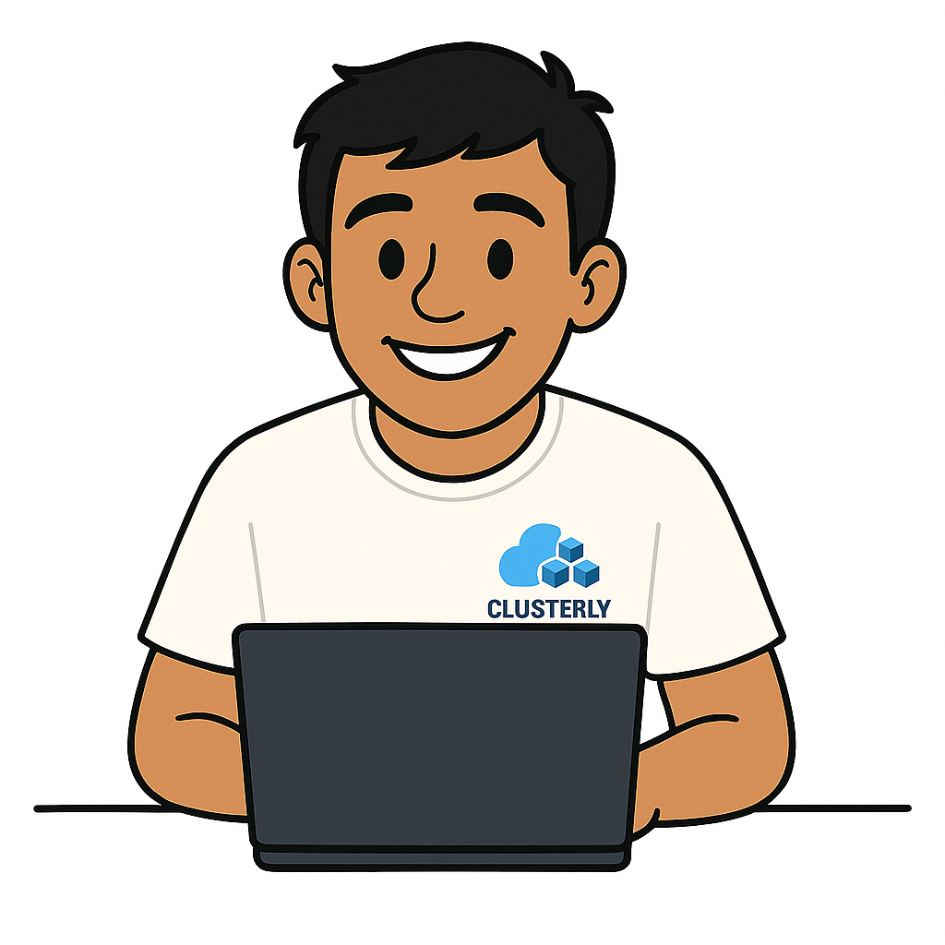

Aditya’s Journey
Excited to build the Cart backend! Let’s ship innovation 😄
Cart Microservice
Notes:
Energised, Aditya clones the repo, skims the README, and runs the unit tests—green across the board. But the production bug persists, so he needs a full repro.

Slide 6

Aditya’s Journey
Redis Dependency? No worries, spinning it up 😌
Cart Microservice
Redis

Slide 7

Aditya’s Journey
Cart API up and running - Next Store UI 🙂
Cart Microservice
Redis
Store UI

Slide 8
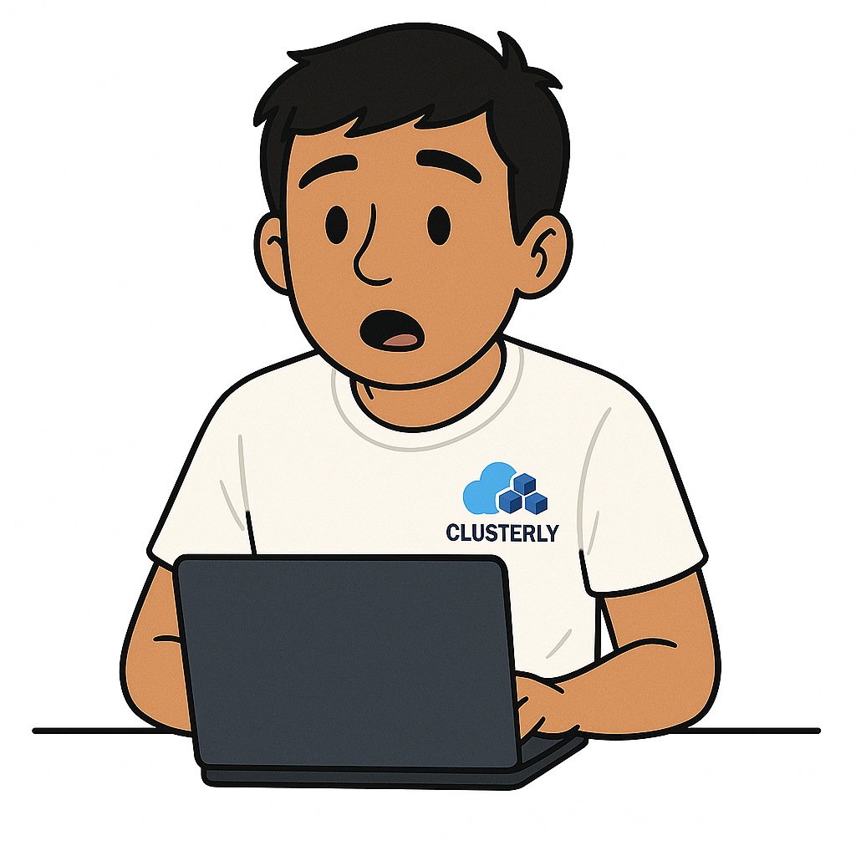

Aditya’s Journey
Wait… Store UI needs Product service for real items? 🤨
Cart Microservice
Redis
Store UI
Product Microservice
Notes:
He tries spinning up five services, two datastores, one SPA UI.

Slide 9

Aditya’s Journey
Oh great, Product needs Mongo running too 😤
Cart Microservice
Redis
Store UI
Mongo DB
Product Microservice

Slide 10
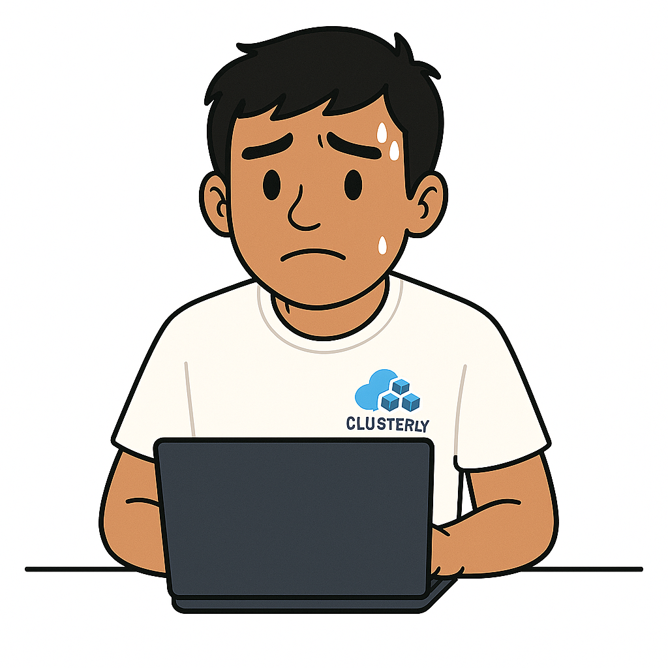

Aditya’s Journey
Still error!! Let me check logs… what even is this?! 😵‍💫

Slide 11

Aditya’s Journey
README is outdated, mentor’s busy — I’m stuck 😓

Slide 12
Aditya’s Journey
What do I do now? Brain officially fried 😫
Cart Microservice
Redis
Store UI
Mongo DB
Product Microservice
Notes:
Everything fails, nothing works and by the end of Day 1 he’s still waiting for that env. Sound familiar?

Slide 13


Share Your Pain: Tell Us About Your Feedback Loop
To see how widespread Aditya’s challenge is, we’d like to hear from you. Please take out your phone and join a quick poll.
Open a browser and go to menti.com, then enter the code
5778 4417
(or)
Scan the QR code on the right
Notes:
If Aditya’s story rings a bell, you’re not alone. Let’s quantify it. Grab your phone, open menti.com, and enter 5778 4417—or just scan the QR. We’ll flash the live results in a minute and see where the room stands.

Slide 14
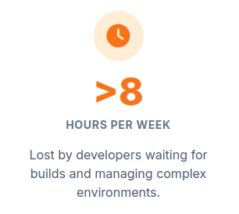
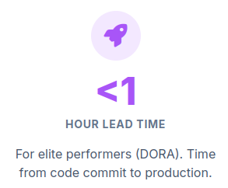
Why Aditya's Wait Matters: The Business Cost of a Slow Loop
Data Sources: [1], [2] [3], [4]
Notes:
Here’s why that wait hurts more than patience. Industry studies show developers burn 8+ hours each week babysitting builds and wrangling environments. Compare that with DORA‑defined elite teams who push from commit to prod in under one hour. Every minute Aditya loses is money down the drain and Clusterly will never reach the Elite Performers as per Dora.

Slide 15
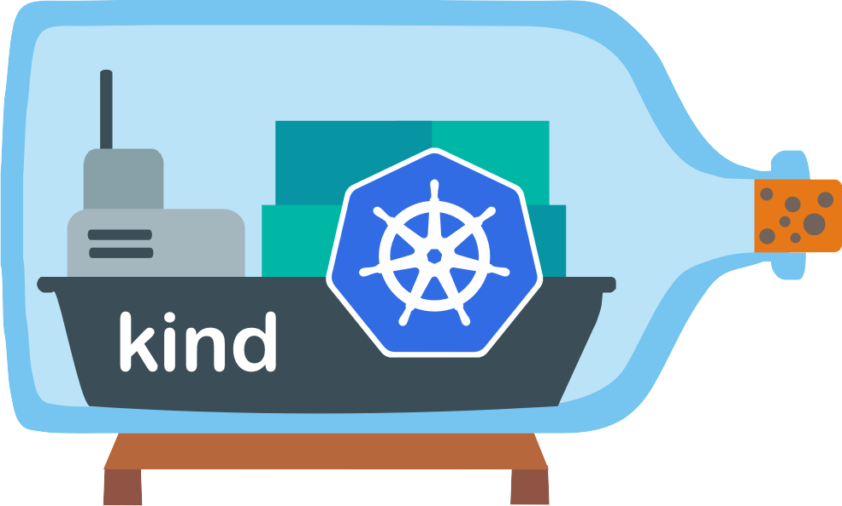

The Accelerator Toolkit
“There’s a better way to work.” - Aditya
Challenges
Setting up realistic local or test clusters is a hassle
The edit-build-push-deploy loop is slow
Debugging apps inside Kubernetes is hard.
Deploying to staging is time-consuming.
With Kind, Get a realistic environment in seconds
With DevSpace,
See code changes instantly.
Automate your entire workflow
Develop anywhere with a consistent process.
Notes:
Aditya decides, “There’s a better way to work.” Challenges we all know: • Realistic local or test clusters are a pain. • Edit‑build‑push‑deploy is glacial. • Debugging inside Kubernetes is tricky. • Shipping to staging eats half a day.
Enter the toolkit: Kind spins up a production‑like cluster on your laptop in seconds. DevSpace hot‑reloads code straight into those pods, scripts your build / deploy flow, and keeps it identical across envs.
Together, they turn a hour long loop into a sub‑second save‑and‑refresh. Up next: we’ll show you exactly how.

Slide 16
The ‘Pro’ Setup
Live Demo
We’ll create a K8s Cluster using Kind and use DevSpace to debug and fix Aditya’s issue
Notes:
Enough slides—time to show, not tell. We’ll:
Spin up a fresh Kind cluster.
Attach DevSpace to the shopping‑cart microservice.
Reproduce Aditya’s bug, patch the code, and watch the fix appear in‑cluster.
We’ve got a fallback recording in case the demo‑gods—or conference Wi‑Fi—betray us, but let’s keep the adrenaline up and run it live. Fingers crossed; here we go!

Slide 17
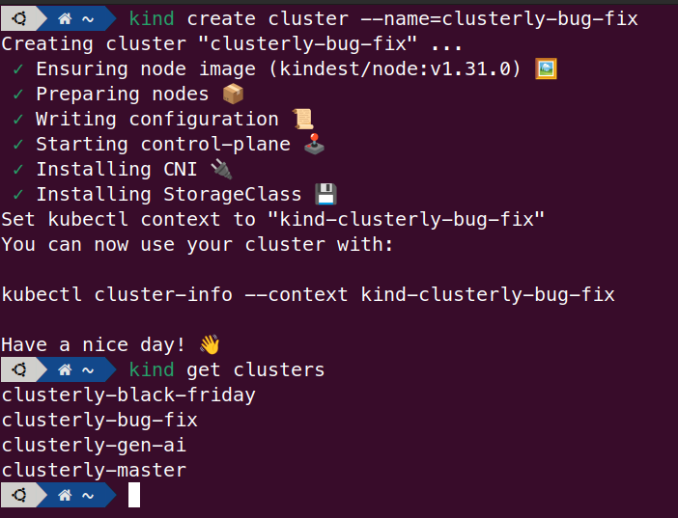
Under the Hood
kind: Cluster
apiVersion: kind.x-k8s.io/v1alpha4
nodes:
- role: control-plane
- role: control-plane
- role: worker
- role: worker
- role: worker
extraPortMappings:
- containerPort: 30080
hostPort: 80
protocol: TCP
- containerPort: 30443
hostPort: 443
protocol: TCP
Ephemeral cluster per branch / task • Zero config drift; always start clean • Auto-create & tear down for every branch/feature
One-YAML multi-node cluster • Spin up control-plane + workers locally • Safely test HA, network policies & failures
Service virtualization • Mock dependent microservices • Focus on a single component, not the whole stack
Notes:
Here’s why the “Pro” workflow scales: Ephemeral cluster per branch – kind create cluster spins up clean‑slate clusters that auto‑tear‑down—no config drift. One‑YAML multi‑node – run control plane + workers locally to trial HA, network policies, even chaos tests. Service virtualisation – I know there are 100 to 1000 microservices mostly and not possible to all. So mock the services you don’t need and focus on the one you do. Tools like vCluster (a shout‑out to yesterday’s Backstage+vlcuster talk by Rakesh & Farhan) slot right in.
Result: safe, disposable, production‑like playgrounds for every feature branch or hot‑fix—without melting your laptop.

Slide 18
Under the Hood
Rapid inner-loop development • Hot-reload your containerized app in seconds
• Sync local files directly into running pods
• Debug services effortlessly — no more grepping logs
Teams need control without complexity
• Develop seamlessly on any K8s cluster — local or remote — as if it's right on your laptop
• Customize dev workflows with simple YAML tweaks beyond the default dev, build, and deploy flows
Developer first design from the start
• Supports dev with guided questions and reusable templates for quick onboarding
• Lightweight CLI integrates cleanly with kubectl workflows; No agents or daemons — zero footprint on your cluster
• DevSpace UI lets you replay or inspect the custom commands
DevSpace is like kubectl on steroids
Notes:
Rapid inner‑loop: hot‑reload containers in seconds, sync local files straight into running pods, and debug live—no more tail‑and‑pray logs. Control without complexity: same lightweight CLI on any cluster (local or remote) and YAML tweaks extend the default dev / build / deploy flows. Developer‑first DNA: guided devspace init, reusable templates, zero agents in‑cluster, and a UI to replay or inspect every command—literally kubectl on steroids.
We fixed Aditya’s bug with just three commands: devspace init → scaffold config devspace dev → live‑sync & debug devspace deploy → ship the patch One YAML, zero context switches, continuous flow.

Slide 19
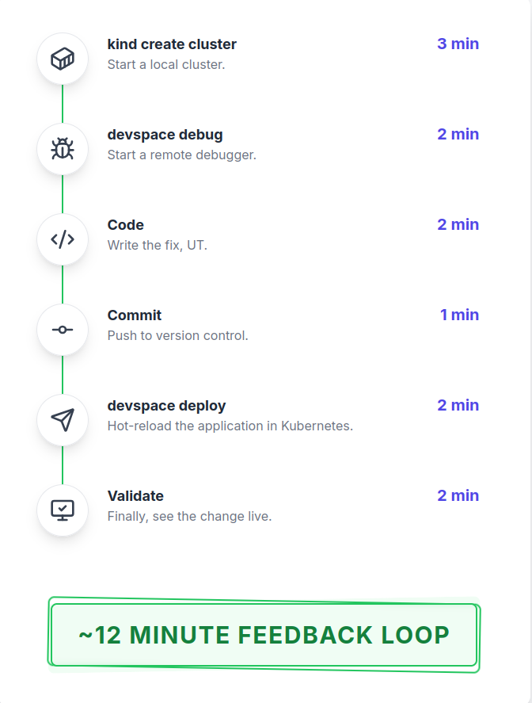
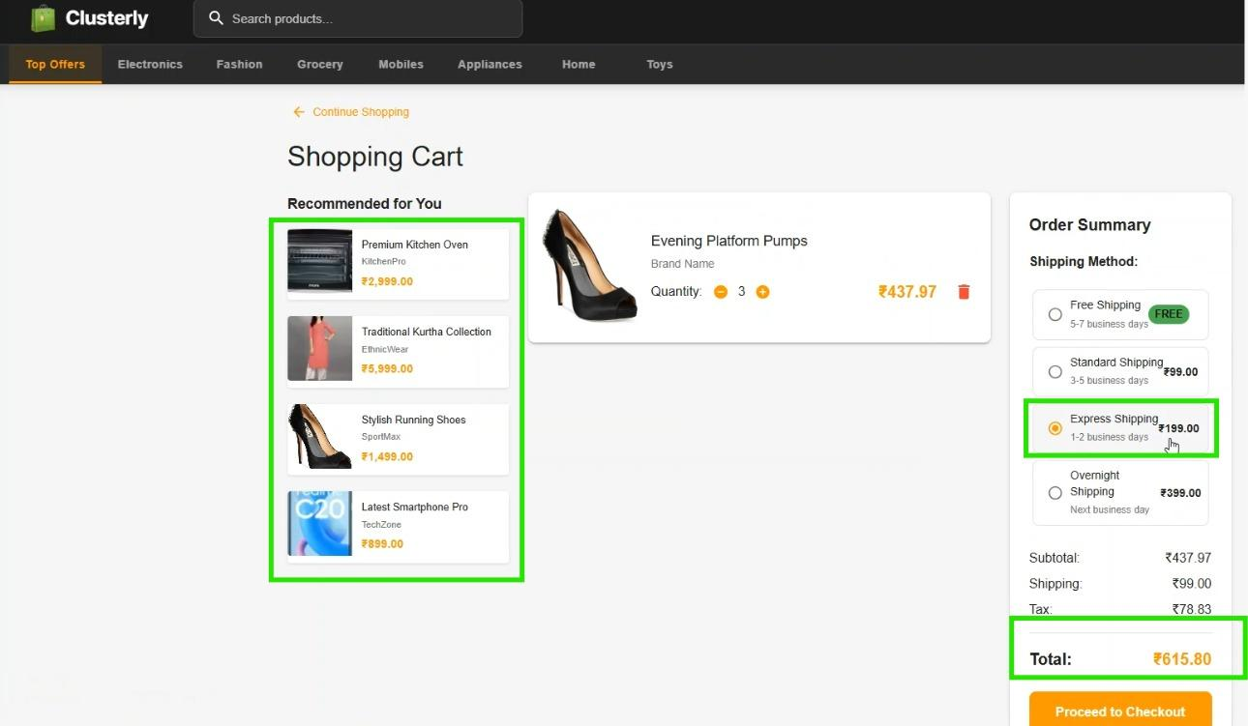
The Pro World: 12 Minute Feedback Loop
Good tools don't just make you faster;
they let you stay in the flow - Aditya
Notes:
Good tools don’t just make you faster; they keep you in the flow. With Kind + DevSpace, Aditya’s entire cycle—from spinning a cluster to validating the fix—shrinks to ≈12 minutes: Six tiny steps, one seamless flow, and a bug fix shipped before the coffee gets cold. Welcome to the pro world.

Slide 20
Key Learnings & Takeaways
Our Learnings
Onboarding time slashed: 1 day ➜ 1 hour
Dev feedback loop accelerated: 60 min ➜ 5 min
Ship a internal CLI tool that bundles all other tooling, so you can swap tools or tweak the flow without disrupting developers.
Instant code comprehension - even for unfamiliar repos
Live, in-IDE debugging in production-like clusters
Takeaways
Shift Left: It's About Fidelity, Not Just Speed
Adapt the Tools to fix Your Bottleneck
Notes:
Our wins: • Onboarding: 1 day → 1 hour. • Dev loop: 60 min → 5 min on average. • An internal CLI wrapper hides YAML and tool churn—devs just type cluster up, dev, deploy. • Instant comprehension with live, in‑IDE debugging against production‑like clusters.
Your playbook: • Shift‑left fidelity—not just speed. The closer to prod, the fewer surprises later. • Tackle your bottleneck first—swap tools freely behind a thin CLI layer. • Automate reset: every branch gets a fresh, disposable env; failure is just kind delete cluster away.
Take these ideas, adapt them, and make waiting in dev loops a relic at your company.

Slide 21
References
[1] DevOps survey showing 69 % of developers lose ≥ 8 hours per week - devops.com
[2] Cortex report indicating 58 % of leaders see > 5 hours/week lost - cortex.io
[3] Article outlining DORA metrics and elite vs low performance benchmarks - datadoghq.com
[4] Report showing improvements in customer satisfaction and employee experience from boosting developer productivity - mckinsey.com

Slide 23



Thank you, Let’s Connect
Raghu Chandrasekaran
Naveenkumar Kumanan
Get the Slides & Demo Code
https://github.com/RaghuChandrasekaran/kubecon-india-2025/

